Slide 1

Amazon Sales Analysis
Done By: KIRIT P S

Slide 2
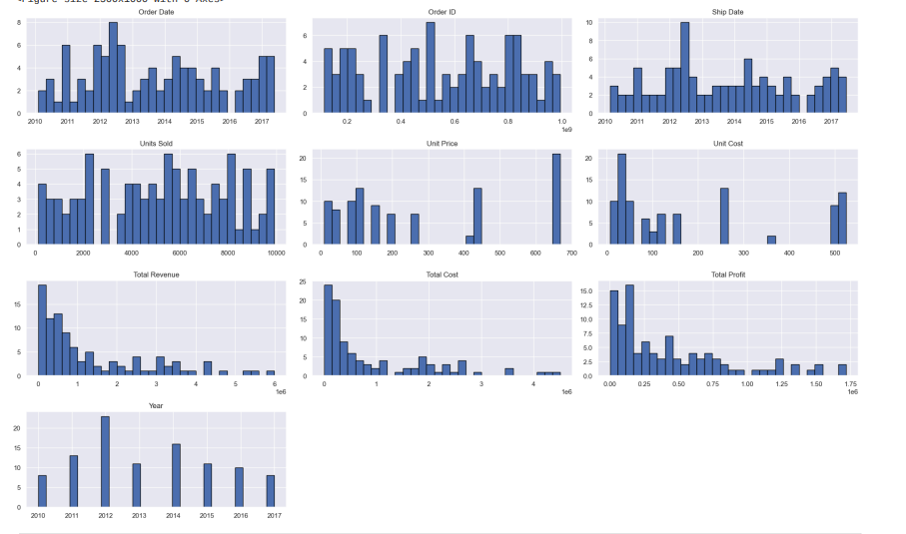
Histogram
This graphical representation aids in identifying patterns such as skewness, modality (unimodal, bimodal, etc.), and the presence of outliers in the dataset, which can be crucial for further statistical analysis and decision-making.

Slide 3
Total Profit Distribution for Each Month in 2010
The bar graph illustrating the total profit distribution for each month in 2010 indicates that February achieved the highest profit, reflecting strong business performance during that period. Conversely, March and May recorded the lowest profits, suggesting potential challenges in sales. Other months like August, June, and December also demonstrated substantial profits, indicating consistent business activity. Overall, the graph provides valuable insights into monthly performance trends, highlighting both peak and low periods for further analysis and strategic planning

Slide 4
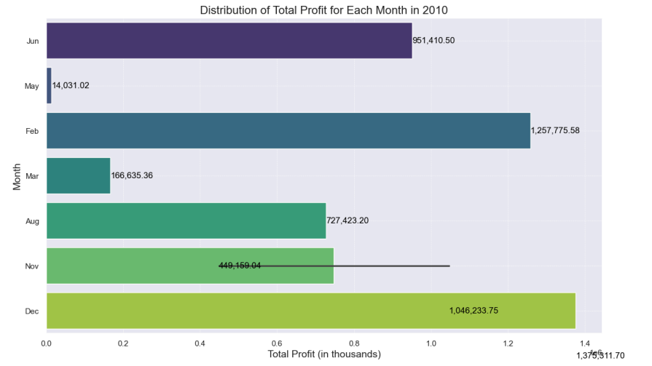
Total Profit Distribution for Each Month in 2010
The bar graph illustrating the total profit distribution for each month in 2010 indicates that February achieved the highest profit, reflecting strong business performance during that period. Conversely, March and May recorded the lowest profits, suggesting potential challenges in sales. Other months like August, June, and December also demonstrated substantial profits, indicating consistent business activity. Overall, the graph provides valuable insights into monthly performance trends, highlighting both peak and low periods for further analysis and strategic planning

Slide 5
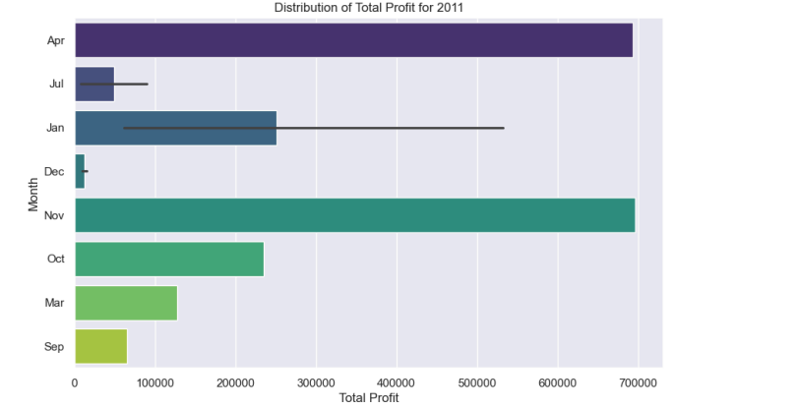
Total Profit Distribution for Each Month in 2011
The bar graph for total profit distribution in 2011 indicates that November achieved the highest total profit, showcasing strong business performance during that month. April also demonstrated significant profits, reflecting robust activities in the spring season. Conversely, January exhibited notable profits but with a large error bar, suggesting variability or uncertainty in the data for that month. Overall, the graph effectively highlights the monthly profit trends, identifying peak performance periods and areas that may require further investigation or improvement

Slide 6
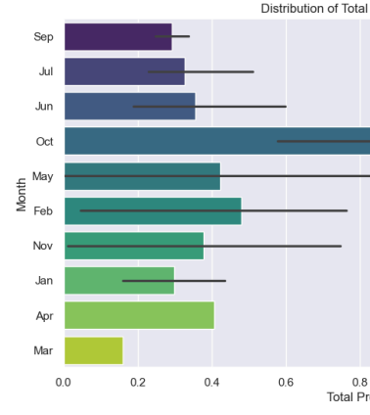
Total Profit Distribution for Each Month in 2012
The bar graph for total profit distribution in 2012 reveals that October achieved the highest total profit, indicating a peak in business performance during that month. February and June also demonstrated strong profits, reflecting effective business activities. Conversely, March and April exhibited relatively lower profits, suggesting potential challenges during these periods. Overall, the graph provides a clear visual representation of the monthly profit trends, helping to identify both peak performance months and areas that may require further analysis or improvement

Slide 7
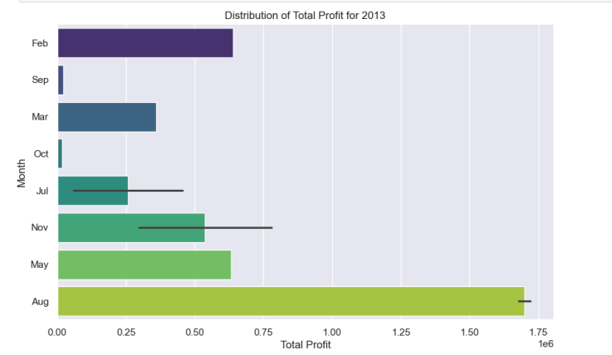
Total Profit Distribution for Each Month in 2013
The total profit distribution for 2013 indicates that August achieved the highest profit, reflecting peak business performance during that month. February also showed strong profits, while September and October experienced lower profits, suggesting potential challenges during these periods. The variability in profits, as indicated by error bars for months like July and November, highlights the need for further investigation into the factors affecting performance

Slide 8
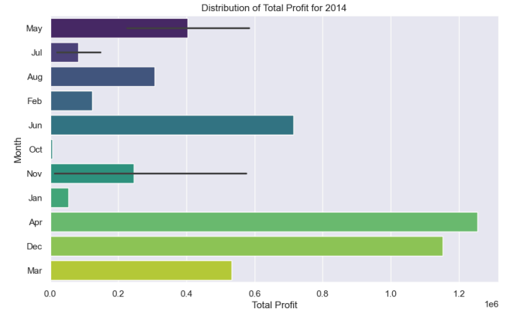
Total Profit Distribution for Each Month in 2014
In 2014, April recorded the highest total profit, indicating a successful business strategy during that month. Conversely, March and December had the lowest profits, suggesting slower business activity. The overall distribution provides insights into the company's performance, helping to identify both peak and low periods for strategic planning

Slide 9
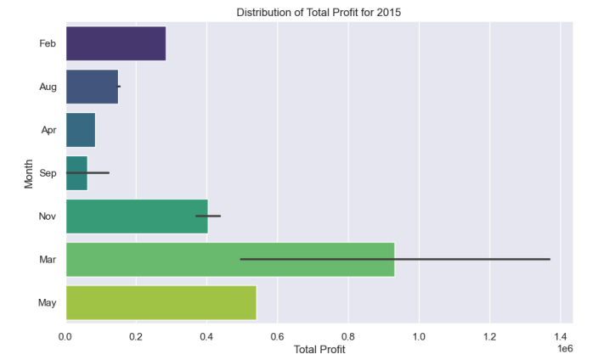
Total Profit Distribution for Each Month in 2015
The year 2015 saw April again as the month with the highest total profit, extending beyond 1.4 million. In contrast, March and December exhibited the lowest profits, while November and May showed moderate profits. The distribution highlights the importance of understanding seasonal trends and their impact on profitability

Slide 10
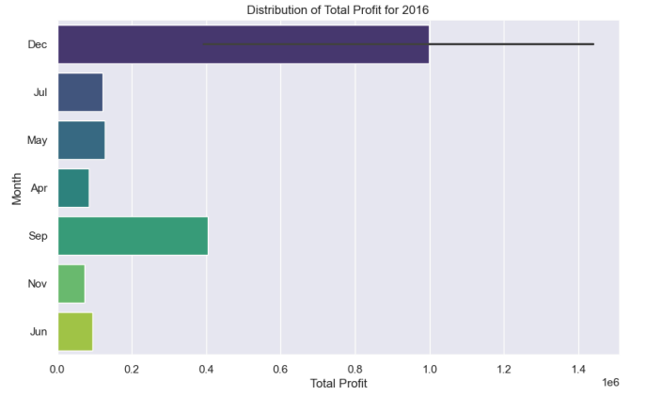
Total Profit Distribution for Each Month in 2016
For 2016, December emerged as the month with the highest total profit,while November and April recorded the lowest profits. The moderate profits in September and May suggest stable business performance, but the overall distribution emphasizes the need for continuous monitoring of monthly performance to identify trends and areas for improvement

Slide 11
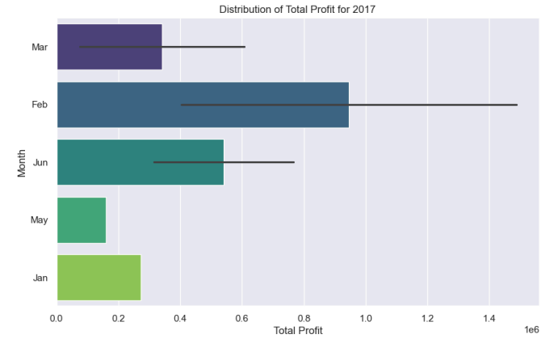
Total Profit Distribution for Each Month in 2017
In 2017, February achieved the highest total profit, surpassing 1.4 million, indicating strong sales during that month. January, June, and March showed moderate profits, while May had the shortest bar, reflecting lower profitability. The distribution underscores the variability in monthly performance, which can inform future business strategies

Slide 12
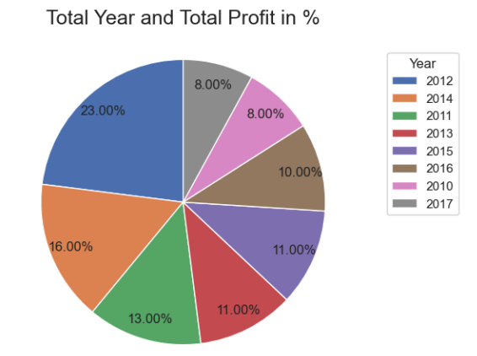
Total Profit by Year
this pie chart serves as a valuable tool for analyzing the company's financial performance over the years, helping stakeholders identify periods of growth and areas that may require further attention or strategic planning

Slide 13
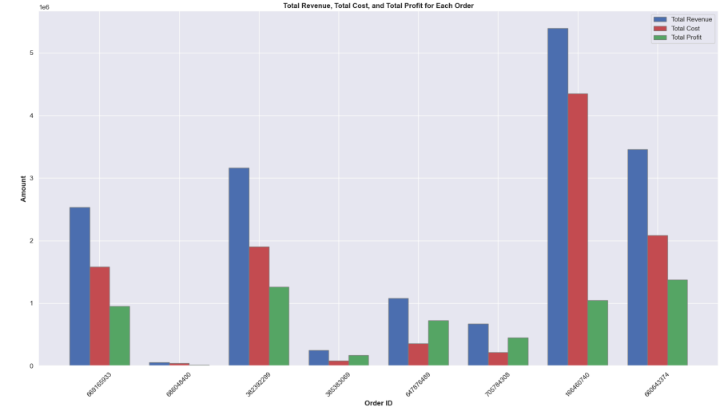
Total Revenue, Total Cost, and Total Profit for Each Order in 2010
The graph allows for easy comparison between these three financial metrics for each order, facilitating insights into which orders were most profitable and which incurred higher costs. The visual representation aids in identifying trends and making informed decisions regarding pricing, cost management, and overall business strategy

Slide 14
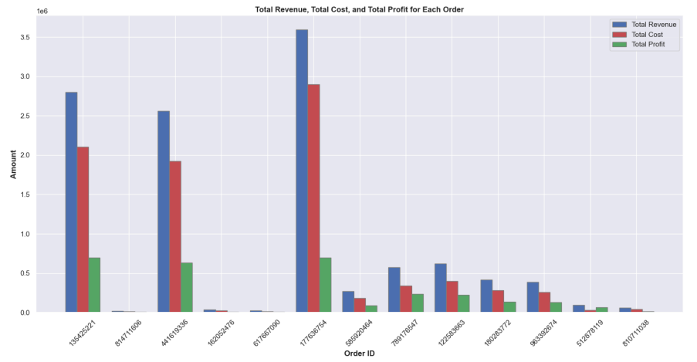
Total Revenue, Total Cost, and Total Profit for Each Order in 2011
The graph allows for easy comparison between these three financial metrics for each order, facilitating insights into which orders were most profitable and which incurred higher costs. The visual representation aids in identifying trends and making informed decisions regarding pricing, cost management, and overall business strategy

Slide 15
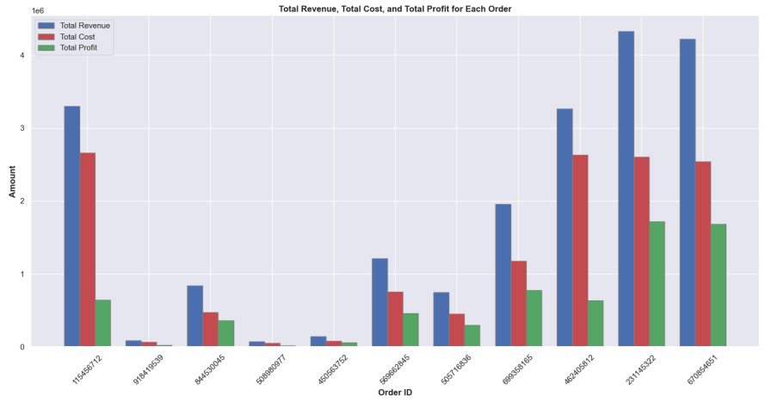
Total Revenue, Total Cost, and Total Profit for Each Order in 2013
The graph allows for straightforward comparisons among the three financial metrics for each order, enabling insights into which orders were most profitable and which incurred higher costs. The visual representation aids in identifying trends and making informed decisions regarding pricing strategies, cost management, and overall business performance

Slide 16
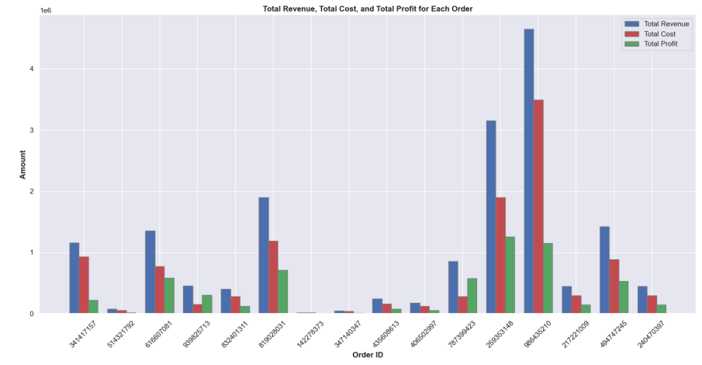
Total Revenue, Total Cost, and Total Profit for Each Order in 2014
The graph allows for straightforward comparisons among these three financial metrics for each order, enabling insights into which orders were most profitable and which incurred higher costs. The visual representation aids in identifying trends and making informed decisions regarding pricing strategies, cost management, and overall business performance

Slide 17
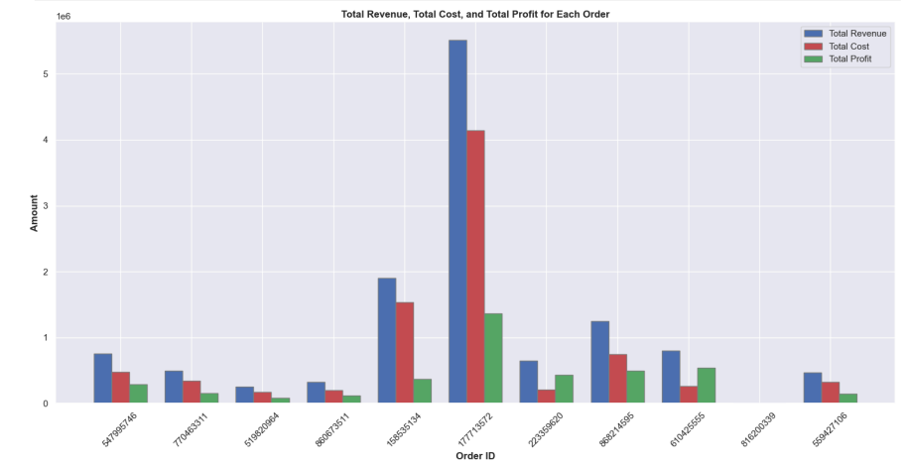
Total Revenue, Total Cost, and Total Profit for Each Order in 2015
The graph allows for straightforward comparisons among these three financial metrics for each order, enabling insights into which orders were most profitable and which incurred higher costs. The visual representation aids in identifying trends and making informed decisions regarding pricing strategies, cost management, and overall business performance

Slide 18
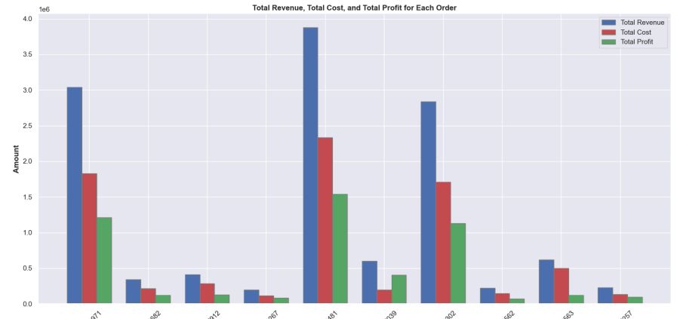
Total Revenue, Total Cost, and Total Profit for Each Order in 2016
The graph allows for straightforward comparisons among these three financial metrics for each order, enabling insights into which orders were most profitable and which incurred higher costs. The visual representation aids in identifying trends and making informed decisions regarding pricing strategies, cost management, and overall business performance

Slide 19
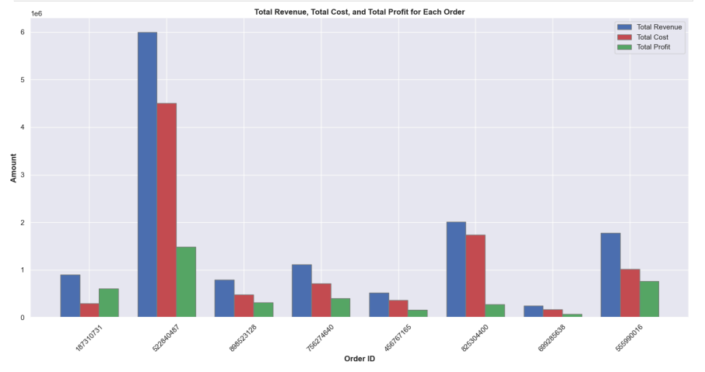
Total Revenue, Total Cost, and Total Profit for Each Order in 2017
The graph allows for straightforward comparisons among these three financial metrics for each order, enabling insights into which orders were most profitable and which incurred higher costs. The visual representation aids in identifying trends and making informed decisions regarding pricing strategies, cost management, and overall business performance

Slide 20
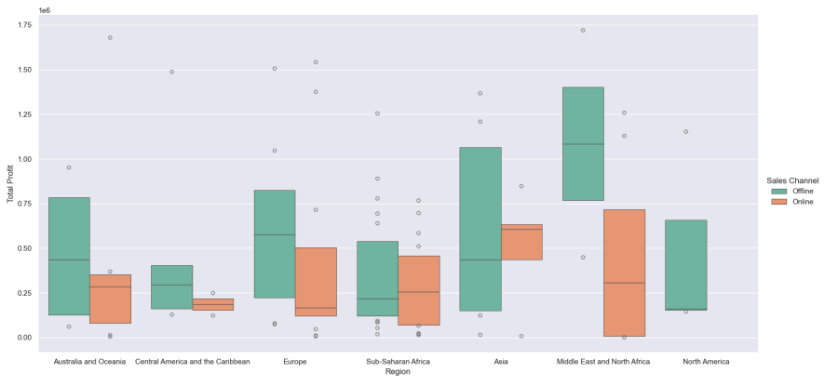
Total Profit by Region and Sales Channel
the boxen plot serves as a powerful tool for visualizing and understanding the relationship between total profit, region, and sales channel, enabling data-driven decision-making

Slide 21
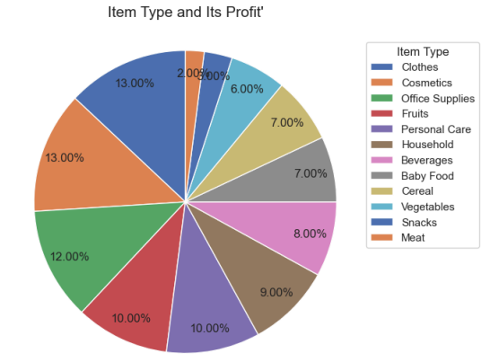
Distribution of Total Profit by Item Type
the pie chart serves as an effective tool for visualizing the profit distribution among item types, facilitating data-driven decision-making in business operations a

Slide 22
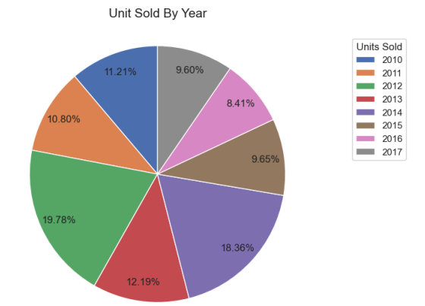
Units Sold by Year
The pie chart serves as an effective tool for visualizing the sales distribution among years, facilitating data-driven decision-making in business operations

Slide 23
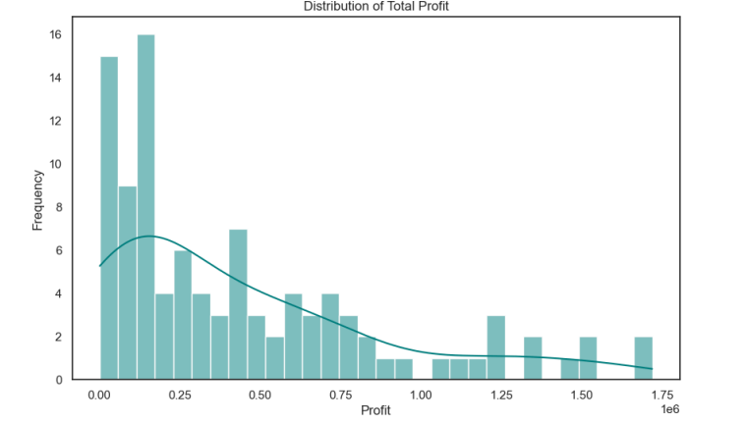
Distribution of Total Profit
the histogram serves as an effective tool for visualizing the distribution of total profit, facilitating a better understanding of profit patterns and aiding in strategic decision-making

Slide 24
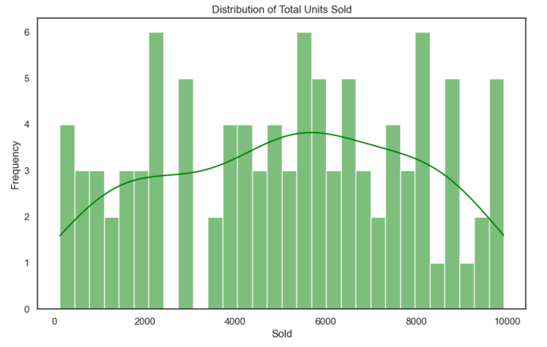
Distribution of Total Units Sold
the histogram serves as an effective tool for visualizing the distribution of total units sold, facilitating a better understanding of sales patterns and aiding in strategic decision-making

Slide 25
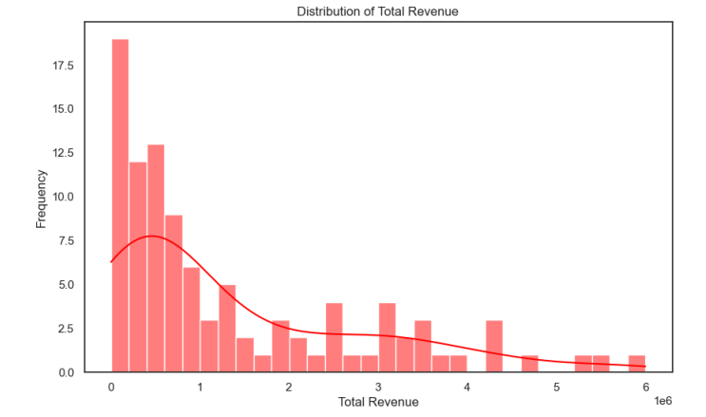
Distribution of Total Revenue
the histogram serves as an effective tool for visualizing the distribution of total revenue, facilitating a better understanding of revenue patterns and aiding in strategic decision-making

Slide 26

THANKYOU

